Slide 1
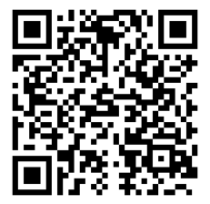
Designing creative and effective SACs that aren't tests
Using Understanding by Design model (UbD)
https://goo.gl/q6qi9M

Slide 2
Backwards design
I use UbD model to develop a task. There are three stages used in this model..
Stage 1—Identify Desired Results
Stage 2—Determine Assessment Evidence
Stage 3—Design the task

Slide 3


Stage 1—Identify Desired Results
Our study design is very crowded. It is impossible to assess all the dot points to any depth in any one SAC so my suggestions is don’t try!
VCAA state:
The decision about satisfactory completion of a unit is distinct from the assessment of levels of achievement.
Notes:
The awarding of an S must be based on on our judgement of the entire outcome. We can design several different tasks and also use ongoing log and work books to make this decision.
The grading of a SAC enables us to assess achievement level for an outcome. It is near impossible to design a task that covers every dot point of an outcome and we are certainly not expected to do so.

Slide 4
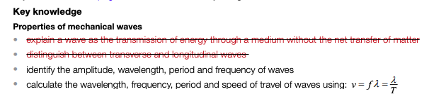
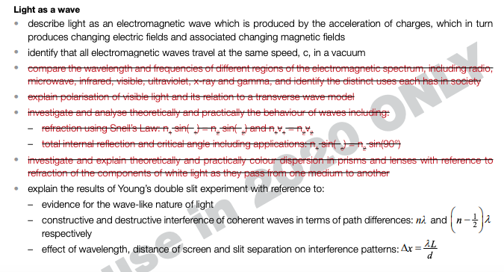
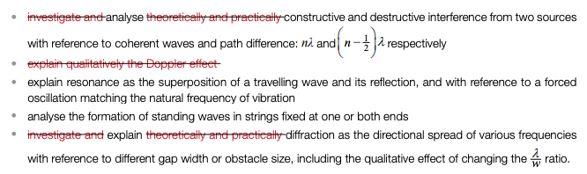
Stage 1—Identify Desired Results
Example for U4 AOS1 - How can waves explain the behaviour of light?
Notes:
The outcome is broad it does not give much guidance and we know we are teaching the dot points.
If we use the UbD model we need to start at the dot points but that has many hazards, mostly being the amount of them.You could not cover them all even in a 50 minute test. To try to have a test that covers all of this is futile and the result would be shallow and the task would not differentiate particularly well.
in addition...

Slide 5
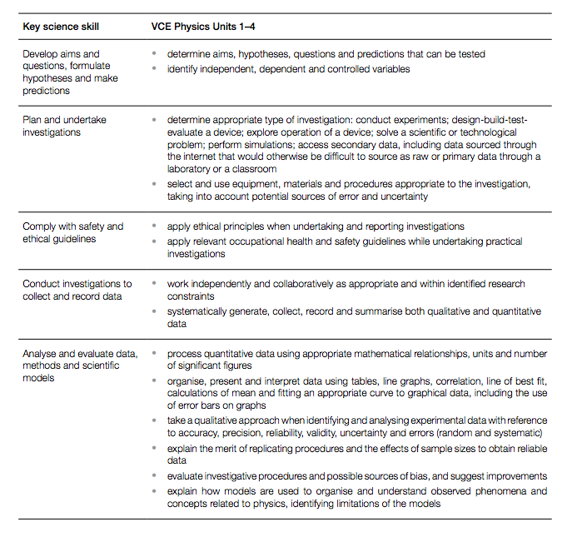
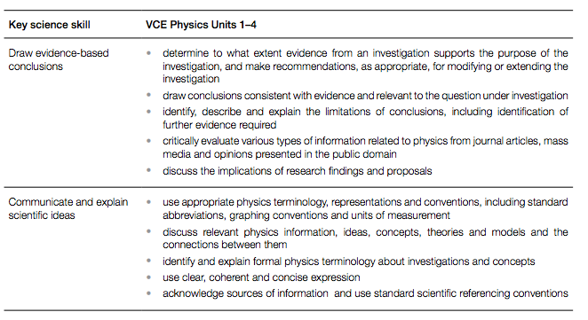
Stage 1—Identify Desired Results
Example for U4 AOS1 - How can waves explain the behaviour of light? - key skills
These have not been changed for the Covid - 19 version
Notes:
We should also be trying to consider the key skills and trying to incorporate these in our task too and then finally, we may realise the deficit or area of focus from previous years or reviewing the assessor’s reports that we want to focus on.

Slide 6
Stage 1—Identify Desired Results
Example for U4 AOS1 - How can waves explain the behaviour of light?
My first task is to make choices and prioritise. I cannot assess this entire Outcome in one SAC. I need to decide what transfer of learning I can achieve with this task.
I know students often struggle with constructive and destructive interference from two sources and it also connects so well to Young’s experiment so I will base my task on these areas.

Slide 7
Stage 1—Identify Desired Results
Example for U4 AOS1 - How can waves explain the behaviour of light?
Set up a table that identifies the Key Knowledge from the Study Design
Focus: Interference of two sources
Primary Key Knowledge | Secondary Key Knowledge

Slide 8
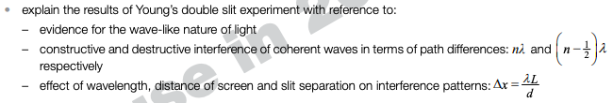
Stage 1—Identify Desired Results
Example for U4 AOS1 - How can waves explain the behaviour of light?
Primary Key Knowledge | Secondary Key Knowledge

Slide 9
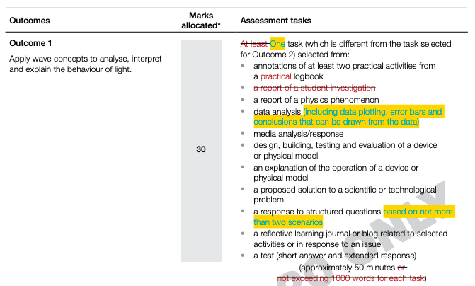
Stage 2—Determine Assessment Evidence
Example for U4 AOS1 - How can waves explain the behaviour of light?
Notes:
For most of us when deciding on the SAC we start at this page in the study design. Most probably you may have a quick re-read of the outcome but mostly focus on what you are going to do for the SAC. The outcome is broad it does not give much guidance and we know we are teaching the dot points.
To use the UbD model we need to start at the dot points but that has many hazards, mostly being the amount of them

Slide 10

Stage 2—Determine Assessment Evidence
Example for U4 AOS1 - How can waves explain the behaviour of light?
My second task is to make choices on how I will collect my evidence.
I will use
This will enable me to ause questions throughout the practical work to get the students thinking about my guiding questions (more to come on this)

Slide 11



Stage 2—Determine Assessment Evidence
Notes:
To determine if our students level of understanding we again might write a task at this point? Or use a commercial one and then perhaps create a rubric to assess it or go to the VCAA rubric and try an see how our assessment marries to the task. In backward planning we need to consider the rubric first. The first rubric to start at is the one provided by VCAA. This is a starting point, but we also need to think about our essential questions.

Slide 12
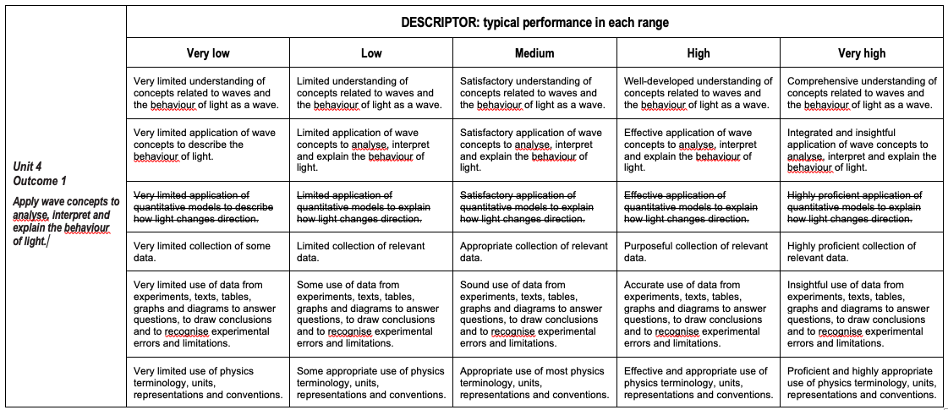
Stage 2—Determine Assessment Evidence
This can be scored during the data and collection process
I will ask the students to refer to their log books, nit draw in the task
Notes:
My goals do not cover the two blue parts of the rubric, the Einsteinian concepts. I will use these two criteria as a guide when I assess these concepts for the Satisfactory.
The other interesting thing to note is how broad the content descriptors are and how only ⅓ of the rubric is content driven criteria

Slide 13
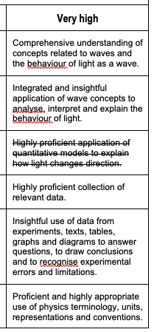
Stage 2—Determine Assessment Evidence
Are any of our students highly proficient at the point we are asking them to sit a SAC?
Notes:
So what do we do next, we have some guiding questions and half a rubric? We need to think about how our guiding questions lead to different levels of competence and what depth could be developed from the essential questions.

Slide 14
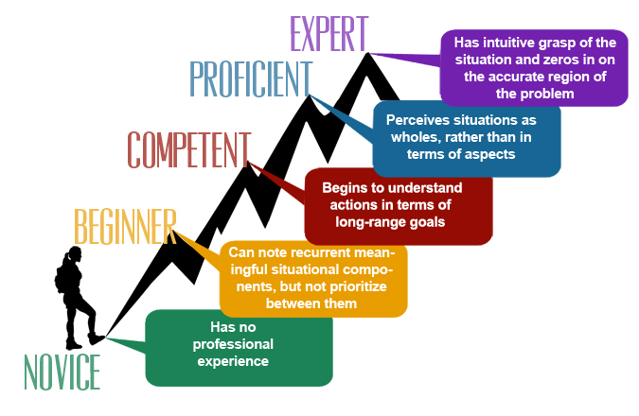
Stage 3 — Design the task
Begins to understand actions in terms of overall concept
Has no experience with the concept
Notes:
As teachers, and experts in our fields, we forget our students are seeing something for the first time, yet often after only a week or two we are expecting them to perform at “highly proficient”
Our students are not at expert level, in fact at most times when we run a SAC our students are not far above novice, so we need to make sure our task differentiates but does not crush then. The majority of your questions or focus, and thus the weight of the marking should be aimed at competent or beginner.

Slide 15
Stage 3—Design the task
Example for U4 AOS1 - How can waves explain the behaviour of light?
Set up a table that identifies the transfer of learning needed through essential questions.
Focus: Interference of two sources
Key Knowledge | Transfer of ideas through essential questions

Slide 16
Stage 3—Design the task
Example for U4 AOS1 - How fast can things go?
Cross study Focus - key skills
Key Knowledge | Transfer of ideas through essential questions
 | How is the amplitude compare or the source wave and the interfered wave? Does the speed of the wave change the max/min produced by interference? How is the wavelength related to path difference? How can we predict a maxima/minima (Node/antinode)? Does the maxima/minima pattern change if you are closer to the source? Given the frequency, how do we find the wavelength for a light wave? (include units conversion)

Slide 17
Stage 3—Design the task
Example for U4 AOS1 - How can waves explain the behaviour of light?
Primary Key Knowledge | Transfer of ideas through essential questions
 | How is the slit size related to spreading of a mechanical wave? Can an interference pattern be created with two gapss in a ripple tank? What is a coherent wave? How is interference shown with light? How is the wavelength related to path difference? How can we predict a maxima/minima (Node/antinode)? Does the maxima/minima pattern change if your screen is closer to the source? How does Young’s experiment justifu the wave model of light?

Slide 18
Stage 3—Design the task
Example for U4 AOS1 - How can waves explain the behaviour of light?
Primary Key Knowledge | Extension questions
 | Does the frequency of the wave change the max/min produced by interference? What would happen to a pattern if the wavelengths are not the same? How did Young achieve coherence and two sources with two slits in a blind? Could an interference pattern be used to find the speed of light?

Slide 19
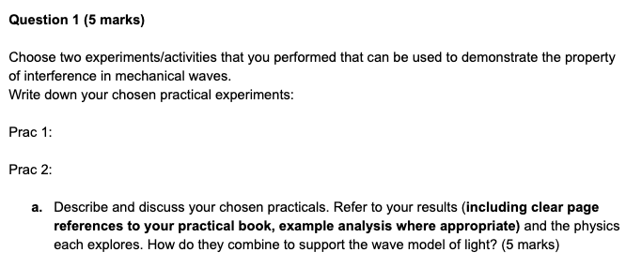
Example for U4 AOS1 - How can waves explain the behaviour of light?
Open ended questions

Slide 20
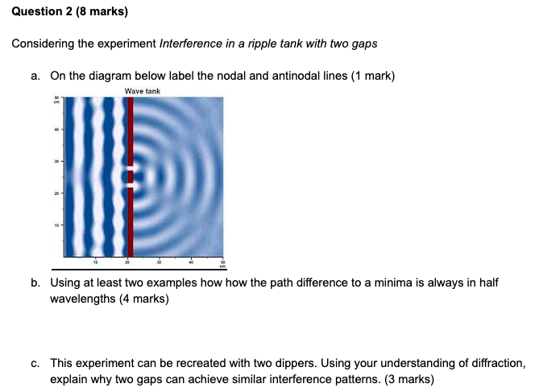
Example for U4 AOS1 - How can waves explain the behaviour of light?
Structured questions

Slide 21
Stage 3 — Design the task
But isn’t this task a test?
open book with log book
students are given a practise task on another set of experiments to model the process
student are told which pracs the Task is based on
student can ask questions of me in the week before task
The task rewards good preparation, attentiveness in class and hard work but requires sound understanding and insight to get the top marks
Notes:
The task required them to work independently but they were allowed to bring their log books to the task, which if they had had answered all of the questions in the pracs offered very good for the task
Asking questions is a culture you need to develop. The students are reticent and believe losing a mark on the “independent” criteria is a disaster when in reality not asking could mean losing marks on every other criteria!!

Slide 22
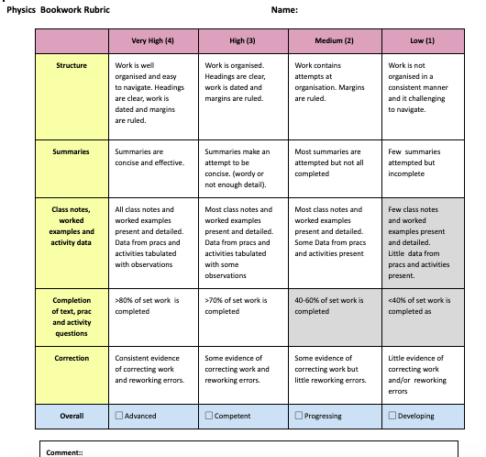
Assessing their notes and logbook.

Slide 23
Yr 11 Discussion forum
One important factor I wanted to encourage with my students is using each other to ask and answer question
So I made a discussion forum part of the assessment in yr 11

Slide 24
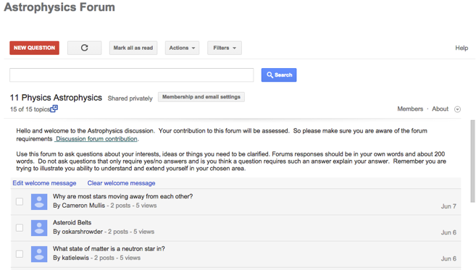

Slide 25
Created in Google Groups
•Students can be invited or enrolled
•Students required to ask a minimum of one question each week
•Students are required to answer a minimum of one question per week
•Students are assessed on frequency of contributions quality of questions and answers and sources referencing
•Can search by student to see all their contributions

Slide 26
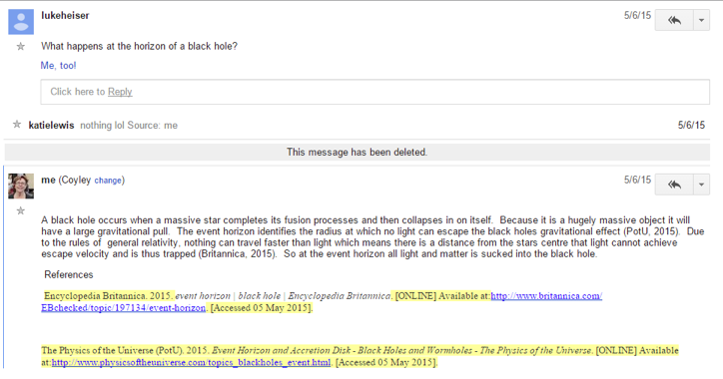
Model your expectations with an example

Slide 27
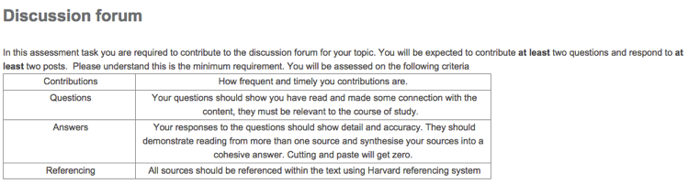
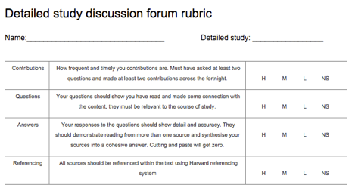

Slide 28
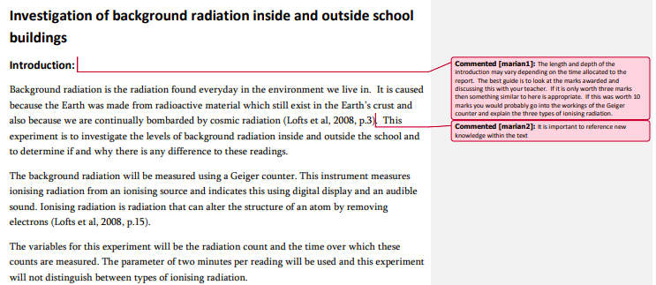
Report writing-Modelling your expectations
Choose a prac they have already done and show what you expect in report.

Slide 29

Thanks for your attention
Jane Coyle: coyleyj@gmail.com
coylej@columba.vic.edu.au
CoyleysVCEPhysics
https://sites.google.com/site/coyleysvcephysics/
To access content presented here please follow the link below
https://shorturl.at/fgiFZ

